Slide 1
Chapter 5
Large and Fast: Exploiting Memory Hierarchy
Notes:
Morgan Kaufmann Publishers
*
Chapter 5 — Large and Fast: Exploiting Memory Hierarchy
‹#›

Slide 2
Principle of Locality
§5.1 Introduction
Programs access a small proportion of their address space at any time
Temporal locality
Items accessed recently are likely to be accessed again soon
e.g., instructions in a loop, induction variables
Spatial locality
Items near those accessed recently are likely to be accessed soon
E.g., sequential instruction access, array data
Chapter 5 — Large and Fast: Exploiting Memory Hierarchy — ‹#›
Notes:
Morgan Kaufmann Publishers
*
Chapter 5 — Large and Fast: Exploiting Memory Hierarchy
‹#›

Slide 3
Taking Advantage of Locality
Memory hierarchy
Store everything on disk
Copy recently accessed (and nearby) items from disk to smaller DRAM memory
Main memory
Copy more recently accessed (and nearby) items from DRAM to smaller SRAM memory
Cache memory attached to CPU
Chapter 5 — Large and Fast: Exploiting Memory Hierarchy — ‹#›
Notes:
Morgan Kaufmann Publishers
*
Chapter 5 — Large and Fast: Exploiting Memory Hierarchy
‹#›

Slide 4
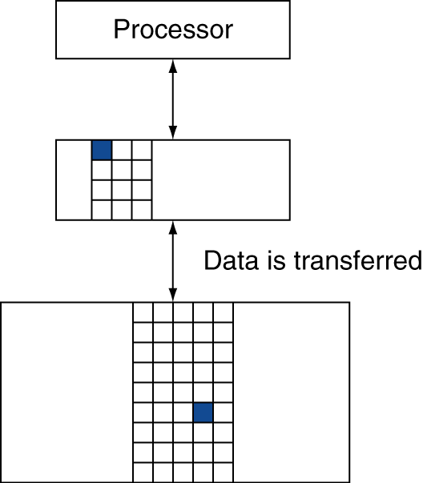
Memory Hierarchy Levels
Block (aka line): unit of copying
May be multiple words
If accessed data is present in upper level
Hit: access satisfied by upper level
Hit ratio: hits/accesses
If accessed data is absent
Miss: block copied from lower level
Time taken: miss penalty
Miss ratio: misses/accesses = 1 – hit ratio
Then accessed data supplied from upper level
Chapter 5 — Large and Fast: Exploiting Memory Hierarchy — ‹#›
Notes:
Morgan Kaufmann Publishers
*
Chapter 5 — Large and Fast: Exploiting Memory Hierarchy
‹#›

Slide 5
Memory Technology
Static RAM (SRAM)
0.5ns – 2.5ns, $2000 – $5000 per GB
Dynamic RAM (DRAM)
50ns – 70ns, $20 – $75 per GB
Magnetic disk
5ms – 20ms, $0.20 – $2 per GB
Ideal memory
Access time of SRAM
Capacity and cost/GB of disk
§5.2 Memory Technologies
Chapter 5 — Large and Fast: Exploiting Memory Hierarchy — ‹#›
Notes:
Morgan Kaufmann Publishers
*
Chapter 5 — Large and Fast: Exploiting Memory Hierarchy
‹#›

Slide 6
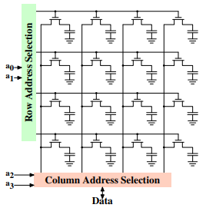
DRAM Technology
Data stored as a charge in a capacitor
Single transistor used to access the charge
Must periodically be refreshed
Read contents and write back
Performed on a DRAM “row”
Chapter 5 — Large and Fast: Exploiting Memory Hierarchy — ‹#›

Slide 7
Advanced DRAM Organization
Bits in a DRAM are organized as a rectangular array
DRAM accesses an entire row
Burst mode: supply successive words from a row with reduced latency
Double data rate (DDR) DRAM
Transfer on rising and falling clock edges
Quad data rate (QDR) DRAM
Separate DDR inputs and outputs
Chapter 5 — Large and Fast: Exploiting Memory Hierarchy — ‹#›
Notes:
Morgan Kaufmann Publishers
*
Chapter 5 — Large and Fast: Exploiting Memory Hierarchy
‹#›

Slide 8
DRAM Generations
Year | Capacity | $/GB
1980 | 64Kbit | $1500000
1983 | 256Kbit | $500000
1985 | 1Mbit | $200000
1989 | 4Mbit | $50000
1992 | 16Mbit | $15000
1996 | 64Mbit | $10000
1998 | 128Mbit | $4000
2000 | 256Mbit | $1000
2004 | 512Mbit | $250
2007 | 1Gbit | $50
Chapter 5 — Large and Fast: Exploiting Memory Hierarchy — ‹#›
Notes:
Morgan Kaufmann Publishers
*
Chapter 5 — Large and Fast: Exploiting Memory Hierarchy
‹#›

Slide 9
DRAM Performance Factors
Row buffer
Allows several words to be read and refreshed in parallel
Synchronous DRAM
Allows for consecutive accesses in bursts without needing to send each address
Improves bandwidth
DRAM banking
Allows simultaneous access to multiple DRAMs
Improves bandwidth
Chapter 5 — Large and Fast: Exploiting Memory Hierarchy — ‹#›

Slide 10

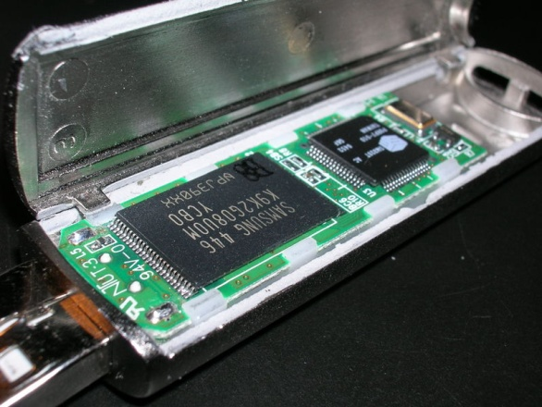
Flash Storage
§6.4 Flash Storage
Nonvolatile semiconductor storage
100× – 1000× faster than disk
Smaller, lower power, more robust
But more $/GB (between disk and DRAM)
Chapter 6 — Storage and Other I/O Topics — ‹#›
Notes:
Morgan Kaufmann Publishers
*
Chapter 6 — Storage and Other I/O Topics
‹#›

Slide 11
Flash Types
NOR flash: bit cell like a NOR gate
Random read/write access
Used for instruction memory in embedded systems
NAND flash: bit cell like a NAND gate
Denser (bits/area), but block-at-a-time access
Cheaper per GB
Used for USB keys, media storage, …
Flash bits wears out after 1000’s of accesses
Not suitable for direct RAM or disk replacement
Wear leveling: remap data to less used blocks
Chapter 6 — Storage and Other I/O Topics — ‹#›
Notes:
Morgan Kaufmann Publishers
*
Chapter 6 — Storage and Other I/O Topics
‹#›

Slide 12

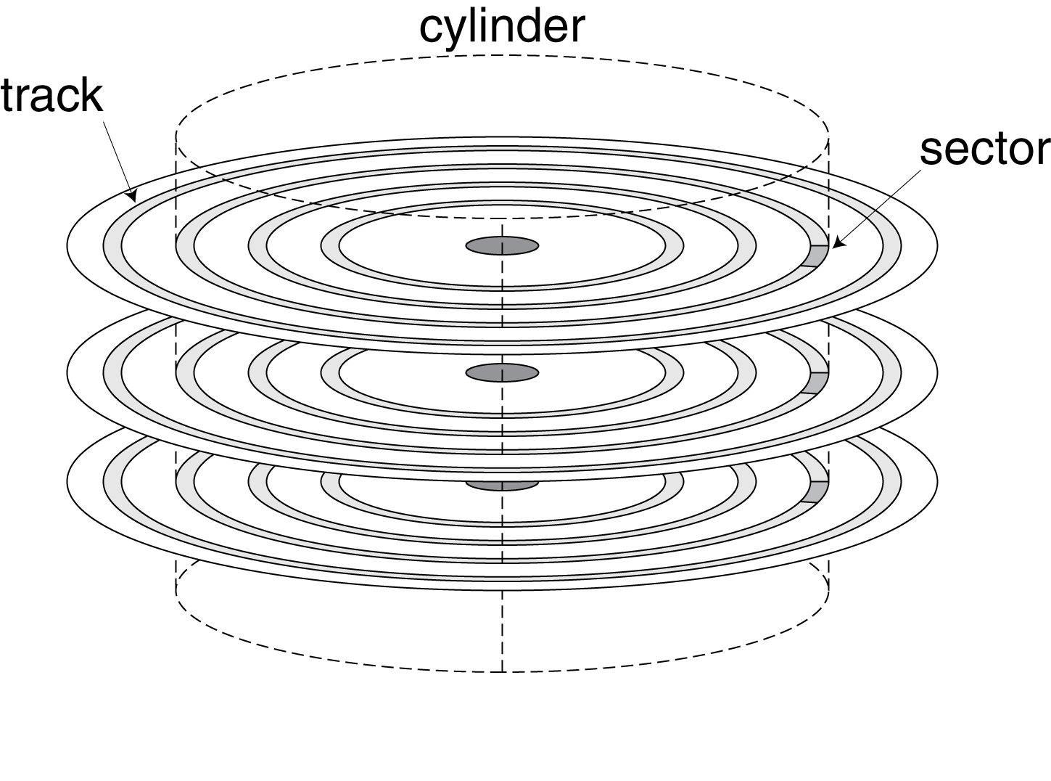
Disk Storage
§6.3 Disk Storage
Nonvolatile, rotating magnetic storage
Chapter 6 — Storage and Other I/O Topics — ‹#›
Notes:
Morgan Kaufmann Publishers
*
Chapter 6 — Storage and Other I/O Topics
‹#›

Slide 13
Disk Sectors and Access
Each sector records
Sector ID
Data (512 bytes, 4096 bytes proposed)
Error correcting code (ECC)
Used to hide defects and recording errors
Synchronization fields and gaps
Access to a sector involves
Queuing delay if other accesses are pending
Seek: move the heads
Rotational latency
Data transfer
Controller overhead
Chapter 6 — Storage and Other I/O Topics — ‹#›
Notes:
Morgan Kaufmann Publishers
*
Chapter 6 — Storage and Other I/O Topics
‹#›

Slide 14
Disk Access Example
Given
512B sector, 15,000rpm, 4ms average seek time, 100MB/s transfer rate, 0.2ms controller overhead, idle disk
Average read time
4ms seek time + ½ / (15,000/60) = 2ms rotational latency + 512 / 100MB/s = 0.005ms transfer time + 0.2ms controller delay = 6.2ms
If actual average seek time is 1ms
Average read time = 3.2ms
Chapter 6 — Storage and Other I/O Topics — ‹#›
Notes:
Morgan Kaufmann Publishers
*
Chapter 6 — Storage and Other I/O Topics
‹#›

Slide 15
Disk Performance Issues
Manufacturers quote average seek time
Based on all possible seeks
Locality and OS scheduling lead to smaller actual average seek times
Smart disk controller allocate physical sectors on disk
Present logical sector interface to host
SCSI, ATA, SATA
Disk drives include caches
Prefetch sectors in anticipation of access
Avoid seek and rotational delay
Chapter 6 — Storage and Other I/O Topics — ‹#›
Notes:
Morgan Kaufmann Publishers
*
Chapter 6 — Storage and Other I/O Topics
‹#›

Slide 16
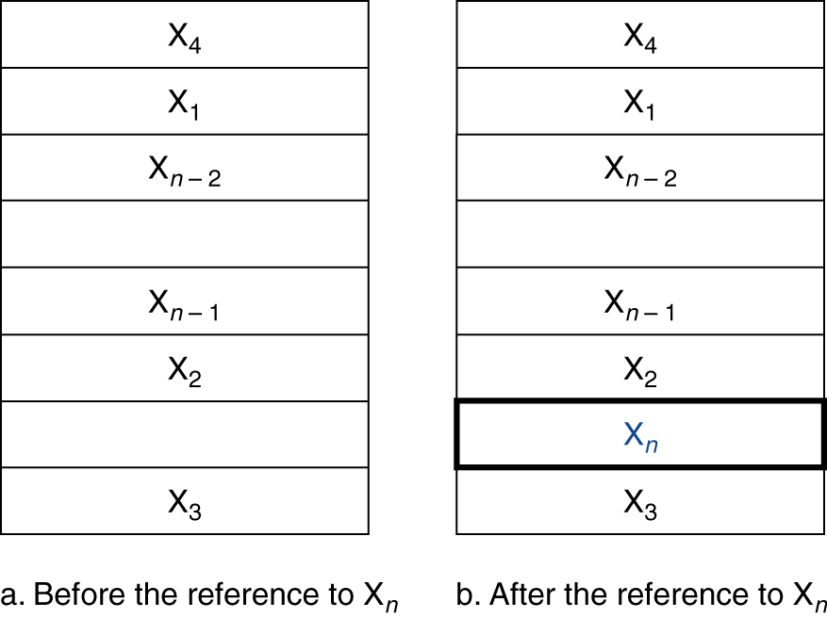
Cache Memory
Cache memory
The level of the memory hierarchy closest to the CPU
Given accesses X₁, …, X_{n–1}, X_{n}
§5.3 The Basics of Caches
How do we know if the data is present?
Where do we look?
Chapter 5 — Large and Fast: Exploiting Memory Hierarchy — ‹#›
Notes:
Morgan Kaufmann Publishers
*
Chapter 5 — Large and Fast: Exploiting Memory Hierarchy
‹#›

Slide 17
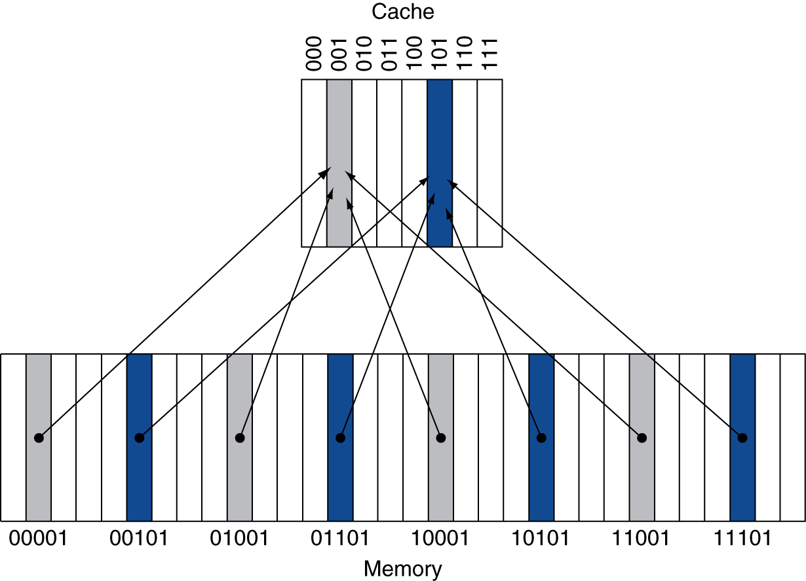
Direct Mapped Cache
Location determined by address
Direct mapped: only one choice
(Block address) modulo (#Blocks in cache)
#Blocks is a power of 2
Use low-order address bits
Chapter 5 — Large and Fast: Exploiting Memory Hierarchy — ‹#›
Notes:
Morgan Kaufmann Publishers
*
Chapter 5 — Large and Fast: Exploiting Memory Hierarchy
‹#›

Slide 18
Tags and Valid Bits
How do we know which particular block is stored in a cache location?
Store block address as well as the data
Actually, only need the high-order bits
Called the tag
What if there is no data in a location?
Valid bit: 1 = present, 0 = not present
Initially 0
Chapter 5 — Large and Fast: Exploiting Memory Hierarchy — ‹#›
Notes:
Morgan Kaufmann Publishers
*
Chapter 5 — Large and Fast: Exploiting Memory Hierarchy
‹#›

Slide 19
Cache Example
8-blocks, 1 word/block, direct mapped
Initial state
Index | V | Tag | Data
000 | N
001 | N
010 | N
011 | N
100 | N
101 | N
110 | N
111 | N
Chapter 5 — Large and Fast: Exploiting Memory Hierarchy — ‹#›
Notes:
Morgan Kaufmann Publishers
*
Chapter 5 — Large and Fast: Exploiting Memory Hierarchy
‹#›

Slide 20
Cache Example
Word addr | Binary addr | Hit/miss | Cache block
22 | 10 110 | Miss | 110
Index | V | Tag | Data
000 | N
001 | N
010 | N
011 | N
100 | N
101 | N
110 | Y | 10 | Mem[10110]
111 | N
Chapter 5 — Large and Fast: Exploiting Memory Hierarchy — ‹#›
Notes:
Morgan Kaufmann Publishers
*
Chapter 5 — Large and Fast: Exploiting Memory Hierarchy
‹#›

Slide 21
Cache Example
Word addr | Binary addr | Hit/miss | Cache block
26 | 11 010 | Miss | 010
Index | V | Tag | Data
000 | N
001 | N
010 | Y | 11 | Mem[11010]
011 | N
100 | N
101 | N
110 | Y | 10 | Mem[10110]
111 | N
Chapter 5 — Large and Fast: Exploiting Memory Hierarchy — ‹#›
Notes:
Morgan Kaufmann Publishers
*
Chapter 5 — Large and Fast: Exploiting Memory Hierarchy
‹#›

Slide 22
Cache Example
Word addr | Binary addr | Hit/miss | Cache block
22 | 10 110 | Hit | 110
26 | 11 010 | Hit | 010
Index | V | Tag | Data
000 | N
001 | N
010 | Y | 11 | Mem[11010]
011 | N
100 | N
101 | N
110 | Y | 10 | Mem[10110]
111 | N
Chapter 5 — Large and Fast: Exploiting Memory Hierarchy — ‹#›
Notes:
Morgan Kaufmann Publishers
*
Chapter 5 — Large and Fast: Exploiting Memory Hierarchy
‹#›

Slide 23
Cache Example
Word addr | Binary addr | Hit/miss | Cache block
16 | 10 000 | Miss | 000
3 | 00 011 | Miss | 011
16 | 10 000 | Hit | 000
Index | V | Tag | Data
000 | Y | 10 | Mem[10000]
001 | N
010 | Y | 11 | Mem[11010]
011 | Y | 00 | Mem[00011]
100 | N
101 | N
110 | Y | 10 | Mem[10110]
111 | N
Chapter 5 — Large and Fast: Exploiting Memory Hierarchy — ‹#›
Notes:
Morgan Kaufmann Publishers
*
Chapter 5 — Large and Fast: Exploiting Memory Hierarchy
‹#›

Slide 24
Cache Example
Word addr | Binary addr | Hit/miss | Cache block
18 | 10 010 | Miss | 010
Index | V | Tag | Data
000 | Y | 10 | Mem[10000]
001 | N
010 | Y | 10 | Mem[10010]
011 | Y | 00 | Mem[00011]
100 | N
101 | N
110 | Y | 10 | Mem[10110]
111 | N
Chapter 5 — Large and Fast: Exploiting Memory Hierarchy — ‹#›
Notes:
Morgan Kaufmann Publishers
*
Chapter 5 — Large and Fast: Exploiting Memory Hierarchy
‹#›

Slide 25
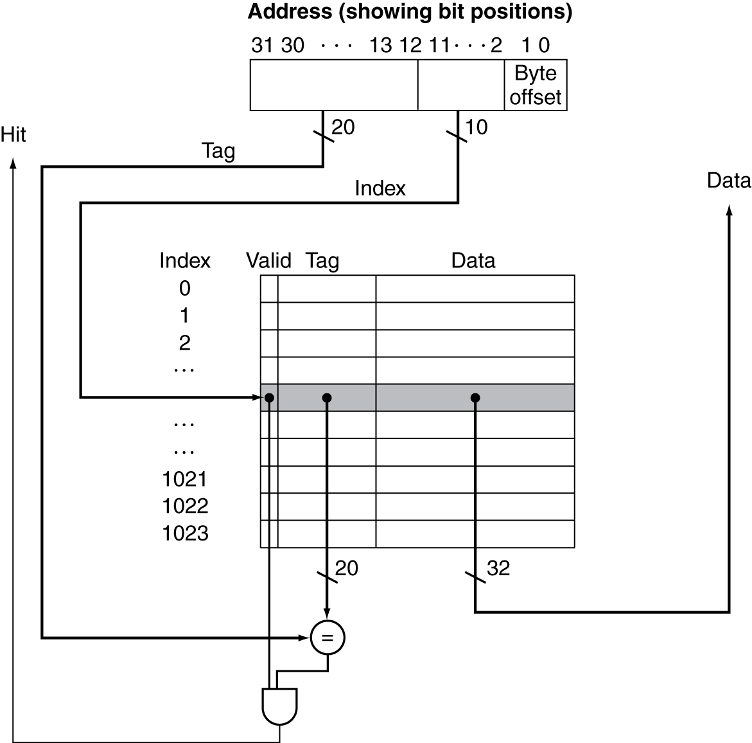
Address Subdivision
Chapter 5 — Large and Fast: Exploiting Memory Hierarchy — ‹#›
Notes:
Morgan Kaufmann Publishers
*
Chapter 5 — Large and Fast: Exploiting Memory Hierarchy
‹#›

Slide 26
Example: Larger Block Size
64 blocks, 16 bytes/block
To what block number does address 1200 map?
Block address = ⎣1200/16⎦ = 75
Block number = 75 modulo 64 = 11
31
10
9
4
3
0
Tag
Index
Offset
22 bits
6 bits
4 bits
Chapter 5 — Large and Fast: Exploiting Memory Hierarchy — ‹#›
Notes:
Morgan Kaufmann Publishers
*
Chapter 5 — Large and Fast: Exploiting Memory Hierarchy
‹#›

Slide 27
Block Size Considerations
Larger blocks should reduce miss rate
Due to spatial locality
But in a fixed-sized cache
Larger blocks ⇒ fewer of them
More competition ⇒ increased miss rate
Larger blocks ⇒ pollution
Larger miss penalty
Can override benefit of reduced miss rate
Early restart and critical-word-first can help
Chapter 5 — Large and Fast: Exploiting Memory Hierarchy — ‹#›
Notes:
Morgan Kaufmann Publishers
*
Chapter 5 — Large and Fast: Exploiting Memory Hierarchy
‹#›

Slide 28
Cache Misses
On cache hit, CPU proceeds normally
On cache miss
Stall the CPU pipeline
Fetch block from next level of hierarchy
Instruction cache miss
Restart instruction fetch
Data cache miss
Complete data access
Chapter 5 — Large and Fast: Exploiting Memory Hierarchy — ‹#›
Notes:
Morgan Kaufmann Publishers
*
Chapter 5 — Large and Fast: Exploiting Memory Hierarchy
‹#›

Slide 29
Write-Through
On data-write hit, could just update the block in cache
But then cache and memory would be inconsistent
Write through: also update memory
But makes writes take longer
e.g., if base CPI = 1, 10% of instructions are stores, write to memory takes 100 cycles
Effective CPI = 1 + 0.1×100 = 11
Solution: write buffer
Holds data waiting to be written to memory
CPU continues immediately
Only stalls on write if write buffer is already full
Chapter 5 — Large and Fast: Exploiting Memory Hierarchy — ‹#›
Notes:
Morgan Kaufmann Publishers
*
Chapter 5 — Large and Fast: Exploiting Memory Hierarchy
‹#›

Slide 30
Write-Back
Alternative: On data-write hit, just update the block in cache
Keep track of whether each block is dirty
When a dirty block is replaced
Write it back to memory
Can use a write buffer to allow replacing block to be read first
Chapter 5 — Large and Fast: Exploiting Memory Hierarchy — ‹#›
Notes:
Morgan Kaufmann Publishers
*
Chapter 5 — Large and Fast: Exploiting Memory Hierarchy
‹#›

Slide 31
Write Allocation
What should happen on a write miss?
Alternatives for write-through
Allocate on miss: fetch the block
Write around: don’t fetch the block
Since programs often write a whole block before reading it (e.g., initialization)
For write-back
Usually fetch the block
Chapter 5 — Large and Fast: Exploiting Memory Hierarchy — ‹#›
Notes:
Morgan Kaufmann Publishers
*
Chapter 5 — Large and Fast: Exploiting Memory Hierarchy
‹#›

Slide 32
Example: Intrinsity FastMATH
Embedded MIPS processor
12-stage pipeline
Instruction and data access on each cycle
Split cache: separate I-cache and D-cache
Each 16KB: 256 blocks × 16 words/block
D-cache: write-through or write-back
SPEC2000 miss rates
I-cache: 0.4%
D-cache: 11.4%
Weighted average: 3.2%
Chapter 5 — Large and Fast: Exploiting Memory Hierarchy — ‹#›
Notes:
Morgan Kaufmann Publishers
*
Chapter 5 — Large and Fast: Exploiting Memory Hierarchy
‹#›

Slide 33
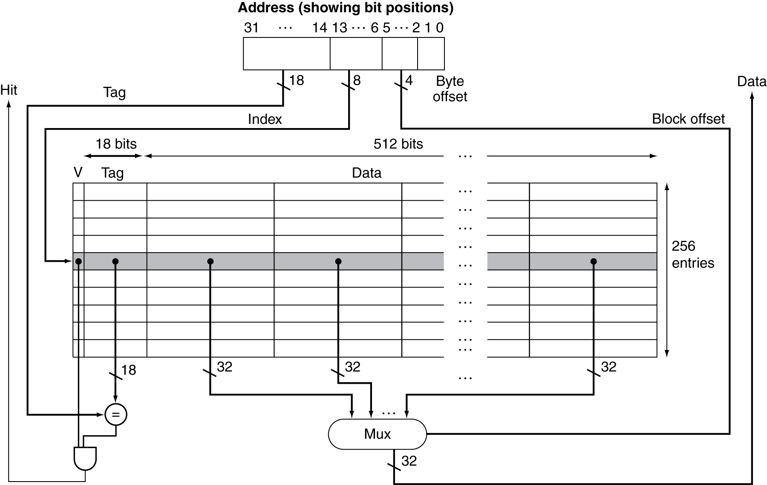
Example: Intrinsity FastMATH
Chapter 5 — Large and Fast: Exploiting Memory Hierarchy — ‹#›
Notes:
Morgan Kaufmann Publishers
*
Chapter 5 — Large and Fast: Exploiting Memory Hierarchy
‹#›

Slide 34
Main Memory Supporting Caches
Use DRAMs for main memory
Fixed width (e.g., 1 word)
Connected by fixed-width clocked bus
Bus clock is typically slower than CPU clock
Example cache block read
1 bus cycle for address transfer
15 bus cycles per DRAM access
1 bus cycle per data transfer
For 4-word block, 1-word-wide DRAM
Miss penalty = 1 + 4×15 + 4×1 = 65 bus cycles
Bandwidth = 16 bytes / 65 cycles = 0.25 B/cycle
Chapter 5 — Large and Fast: Exploiting Memory Hierarchy — ‹#›
Notes:
Morgan Kaufmann Publishers
*
Chapter 5 — Large and Fast: Exploiting Memory Hierarchy
‹#›

Slide 35
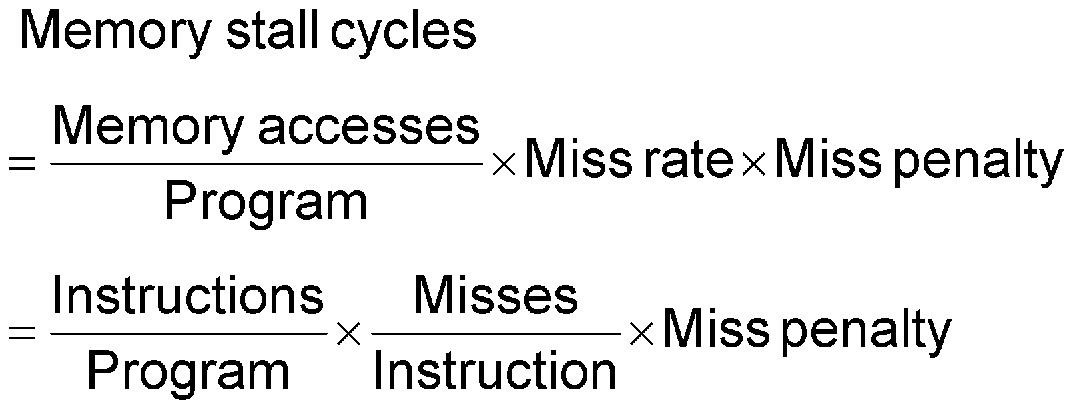
Measuring Cache Performance
Components of CPU time
Program execution cycles
Includes cache hit time
Memory stall cycles
Mainly from cache misses
With simplifying assumptions:
§5.4 Measuring and Improving Cache Performance
Chapter 5 — Large and Fast: Exploiting Memory Hierarchy — ‹#›
Notes:
Morgan Kaufmann Publishers
*
Chapter 5 — Large and Fast: Exploiting Memory Hierarchy
‹#›

Slide 36
Cache Performance Example
Given
I-cache miss rate = 2%
D-cache miss rate = 4%
Miss penalty = 100 cycles
Base CPI (ideal cache) = 2
Load & stores are 36% of instructions
Miss cycles per instruction
I-cache: 0.02 × 100 = 2
D-cache: 0.36 × 0.04 × 100 = 1.44
Actual CPI = 2 + 2 + 1.44 = 5.44
Ideal CPU is 5.44/2 =2.72 times faster
Chapter 5 — Large and Fast: Exploiting Memory Hierarchy — ‹#›
Notes:
Morgan Kaufmann Publishers
*
Chapter 5 — Large and Fast: Exploiting Memory Hierarchy
‹#›

Slide 37
Average Access Time
Hit time is also important for performance
Average memory access time (AMAT)
AMAT = Hit time + Miss rate × Miss penalty
Example
CPU with 1ns clock, hit time = 1 cycle, miss penalty = 20 cycles, I-cache miss rate = 5%
AMAT = 1 + 0.05 × 20 = 2ns
2 cycles per instruction
Chapter 5 — Large and Fast: Exploiting Memory Hierarchy — ‹#›
Notes:
Morgan Kaufmann Publishers
*
Chapter 5 — Large and Fast: Exploiting Memory Hierarchy
‹#›

Slide 38
Performance Summary
When CPU performance increased
Miss penalty becomes more significant
Decreasing base CPI
Greater proportion of time spent on memory stalls
Increasing clock rate
Memory stalls account for more CPU cycles
Can’t neglect cache behavior when evaluating system performance
Chapter 5 — Large and Fast: Exploiting Memory Hierarchy — ‹#›
Notes:
Morgan Kaufmann Publishers
*
Chapter 5 — Large and Fast: Exploiting Memory Hierarchy
‹#›

Slide 39
Associative Caches
Fully associative
Allow a given block to go in any cache entry
Requires all entries to be searched at once
Comparator per entry (expensive)
n-way set associative
Each set contains n entries
Block number determines which set
(Block number) modulo (#Sets in cache)
Search all entries in a given set at once
n comparators (less expensive)
Chapter 5 — Large and Fast: Exploiting Memory Hierarchy — ‹#›
Notes:
Morgan Kaufmann Publishers
*
Chapter 5 — Large and Fast: Exploiting Memory Hierarchy
‹#›

Slide 40
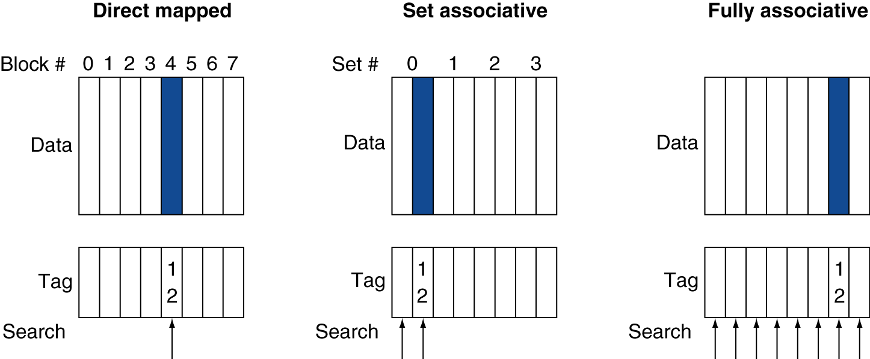
Associative Cache Example
Chapter 5 — Large and Fast: Exploiting Memory Hierarchy — ‹#›
Notes:
Morgan Kaufmann Publishers
*
Chapter 5 — Large and Fast: Exploiting Memory Hierarchy
‹#›

Slide 41
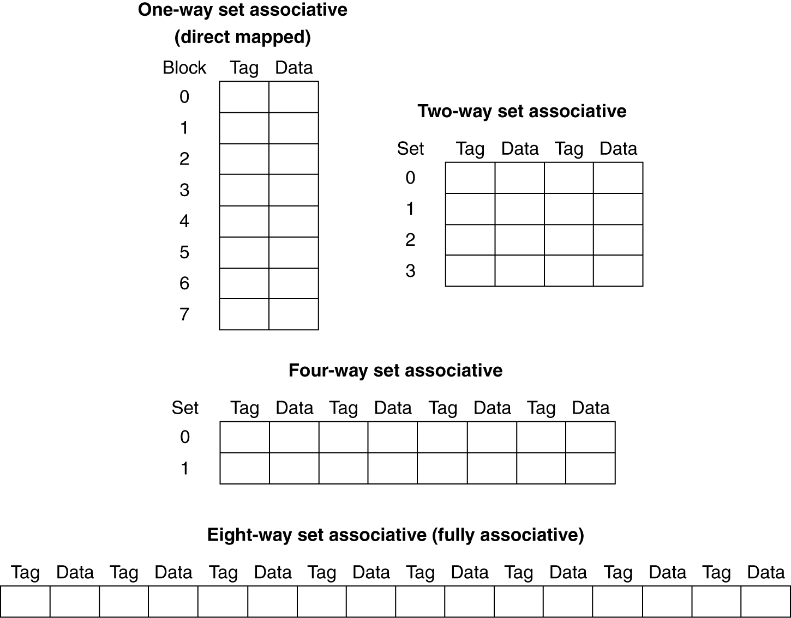
Spectrum of Associativity
For a cache with 8 entries
Chapter 5 — Large and Fast: Exploiting Memory Hierarchy — ‹#›
Notes:
Morgan Kaufmann Publishers
*
Chapter 5 — Large and Fast: Exploiting Memory Hierarchy
‹#›

Slide 42
Associativity Example
Compare 4-block caches
Direct mapped, 2-way set associative, fully associative
Block access sequence: 0, 8, 0, 6, 8
Direct mapped
Block address | Cache index | Hit/miss | Cache content after access
 |  |  | 0 | 1 | 2 | 3
0 | 0 | miss | Mem[0]
8 | 0 | miss | Mem[8]
0 | 0 | miss | Mem[0]
6 | 2 | miss | Mem[0] |  | Mem[6]
8 | 0 | miss | Mem[8] |  | Mem[6]
Chapter 5 — Large and Fast: Exploiting Memory Hierarchy — ‹#›
Notes:
Morgan Kaufmann Publishers
*
Chapter 5 — Large and Fast: Exploiting Memory Hierarchy
‹#›

Slide 43
Associativity Example
2-way set associative
Block address | Cache index | Hit/miss | Cache content after access
 |  |  | Set 0 |  | Set 1
0 | 0 | miss | Mem[0]
8 | 0 | miss | Mem[0] | Mem[8]
0 | 0 | hit | Mem[0] | Mem[8]
6 | 0 | miss | Mem[0] | Mem[6]
8 | 0 | miss | Mem[8] | Mem[6]
Fully associative
Block address |  | Hit/miss | Cache content after access
0 |  | miss | Mem[0]
8 |  | miss | Mem[0] | Mem[8]
0 |  | hit | Mem[0] | Mem[8]
6 |  | miss | Mem[0] | Mem[8] | Mem[6]
8 |  | hit | Mem[0] | Mem[8] | Mem[6]
Chapter 5 — Large and Fast: Exploiting Memory Hierarchy — ‹#›
Notes:
Morgan Kaufmann Publishers
*
Chapter 5 — Large and Fast: Exploiting Memory Hierarchy
‹#›

Slide 44
How Much Associativity
Increased associativity decreases miss rate
But with diminishing returns
Simulation of a system with 64KB D-cache, 16-word blocks, SPEC2000
1-way: 10.3%
2-way: 8.6%
4-way: 8.3%
8-way: 8.1%
Chapter 5 — Large and Fast: Exploiting Memory Hierarchy — ‹#›
Notes:
Morgan Kaufmann Publishers
*
Chapter 5 — Large and Fast: Exploiting Memory Hierarchy
‹#›

Slide 47
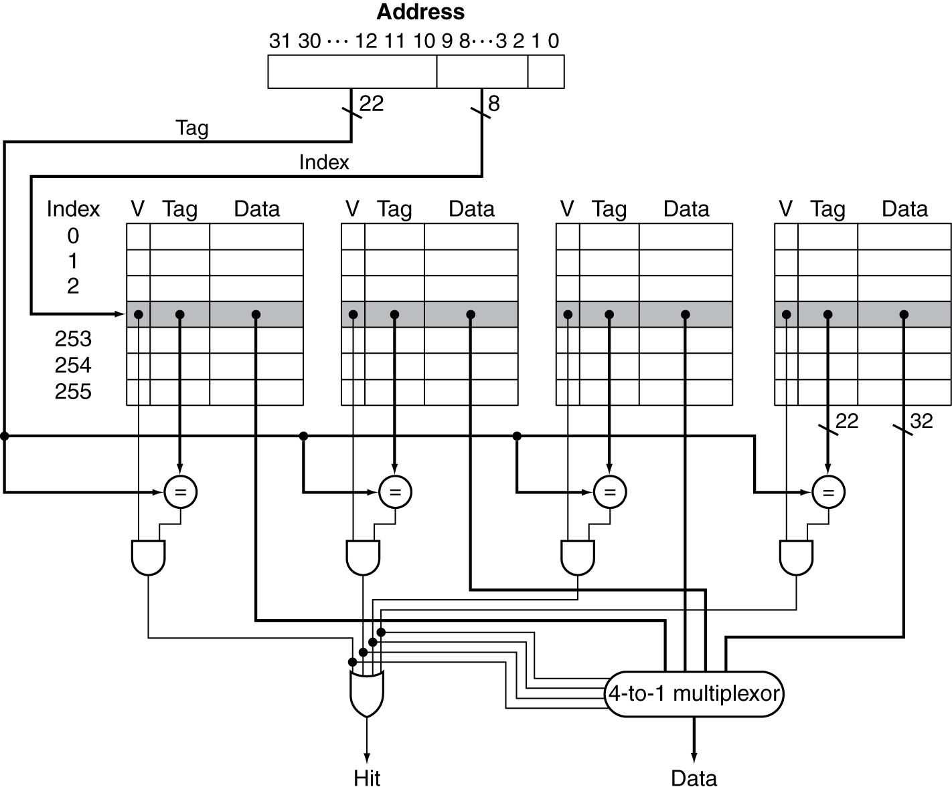
Set Associative Cache Organization
Chapter 5 — Large and Fast: Exploiting Memory Hierarchy — ‹#›
Notes:
Morgan Kaufmann Publishers
*
Chapter 5 — Large and Fast: Exploiting Memory Hierarchy
‹#›

Slide 48
Replacement Policy
Direct mapped: no choice
Set associative
Prefer non-valid entry, if there is one
Otherwise, choose among entries in the set
Least-recently used (LRU)
Choose the one unused for the longest time
Simple for 2-way, manageable for 4-way, too hard beyond that
Random
Gives approximately the same performance as LRU for high associativity
Chapter 5 — Large and Fast: Exploiting Memory Hierarchy — ‹#›
Notes:
Morgan Kaufmann Publishers
*
Chapter 5 — Large and Fast: Exploiting Memory Hierarchy
‹#›

Slide 49
Multilevel Caches
Primary cache attached to CPU
Small, but fast
Level-2 cache services misses from primary cache
Larger, slower, but still faster than main memory
Main memory services L-2 cache misses
Some high-end systems include L-3 cache
Chapter 5 — Large and Fast: Exploiting Memory Hierarchy — ‹#›
Notes:
Morgan Kaufmann Publishers
*
Chapter 5 — Large and Fast: Exploiting Memory Hierarchy
‹#›

Slide 50
Multilevel Cache Example
Given
CPU base CPI = 1, clock rate = 4GHz
Miss rate/instruction = 2%
Main memory access time = 100ns
With just primary cache
Miss penalty = 100ns/0.25ns = 400 cycles
Effective CPI = 1 + 0.02 × 400 = 9
Chapter 5 — Large and Fast: Exploiting Memory Hierarchy — ‹#›
Notes:
Morgan Kaufmann Publishers
*
Chapter 5 — Large and Fast: Exploiting Memory Hierarchy
‹#›

Slide 51
Example (cont.)
Now add L-2 cache
Access time = 5ns
Global miss rate to main memory = 0.5%
Primary miss with L-2 hit
Penalty = 5ns/0.25ns = 20 cycles
Primary miss with L-2 miss
Extra penalty = 500 cycles
CPI = 1 + 0.02 × 20 + 0.005 × 400 = 3.4
Performance ratio = 9/3.4 = 2.6
Chapter 5 — Large and Fast: Exploiting Memory Hierarchy — ‹#›
Notes:
Morgan Kaufmann Publishers
*
Chapter 5 — Large and Fast: Exploiting Memory Hierarchy
‹#›

Slide 52
Multilevel Cache Considerations
Primary cache
Focus on minimal hit time
L-2 cache
Focus on low miss rate to avoid main memory access
Hit time has less overall impact
Results
L-1 cache usually smaller than a single cache
L-1 block size smaller than L-2 block size
Chapter 5 — Large and Fast: Exploiting Memory Hierarchy — ‹#›
Notes:
Morgan Kaufmann Publishers
*
Chapter 5 — Large and Fast: Exploiting Memory Hierarchy
‹#›

Slide 53
Interactions with Advanced CPUs
Out-of-order CPUs can execute instructions during cache miss
Pending store stays in load/store unit
Dependent instructions wait in reservation stations
Independent instructions continue
Effect of miss depends on program data flow
Much harder to analyse
Use system simulation
Chapter 5 — Large and Fast: Exploiting Memory Hierarchy — ‹#›
Notes:
Morgan Kaufmann Publishers
*
Chapter 5 — Large and Fast: Exploiting Memory Hierarchy
‹#›

Slide 54
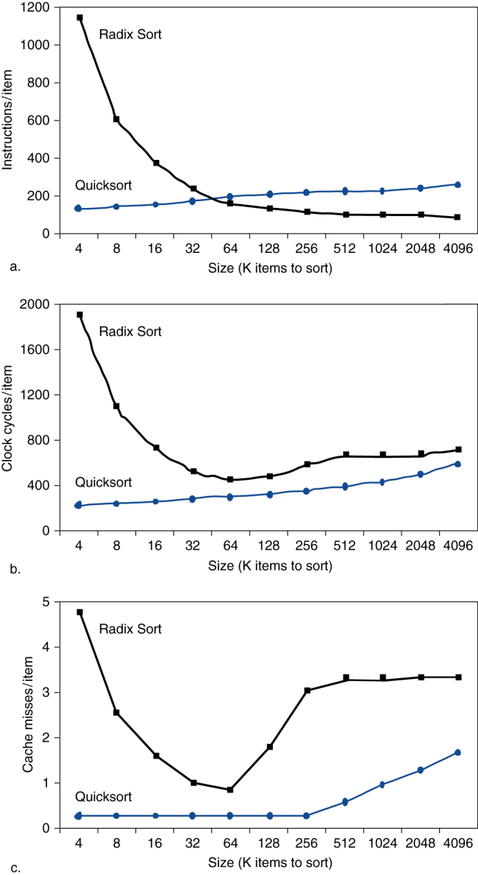
Interactions with Software
Misses depend on memory access patterns
Algorithm behavior
Compiler optimization for memory access
Chapter 5 — Large and Fast: Exploiting Memory Hierarchy — ‹#›
Notes:
Morgan Kaufmann Publishers
*
Chapter 5 — Large and Fast: Exploiting Memory Hierarchy
‹#›

Slide 55
Software Optimization via Blocking
Goal: maximize accesses to data before it is replaced
Consider inner loops of DGEMM:
for (int j = 0; j < n; ++j)
{
double cij = C[i+j*n];
for( int k = 0; k < n; k++ )
cij += A[i+k*n] * B[k+j*n];
C[i+j*n] = cij;
}
Chapter 5 — Large and Fast: Exploiting Memory Hierarchy — ‹#›

Slide 56
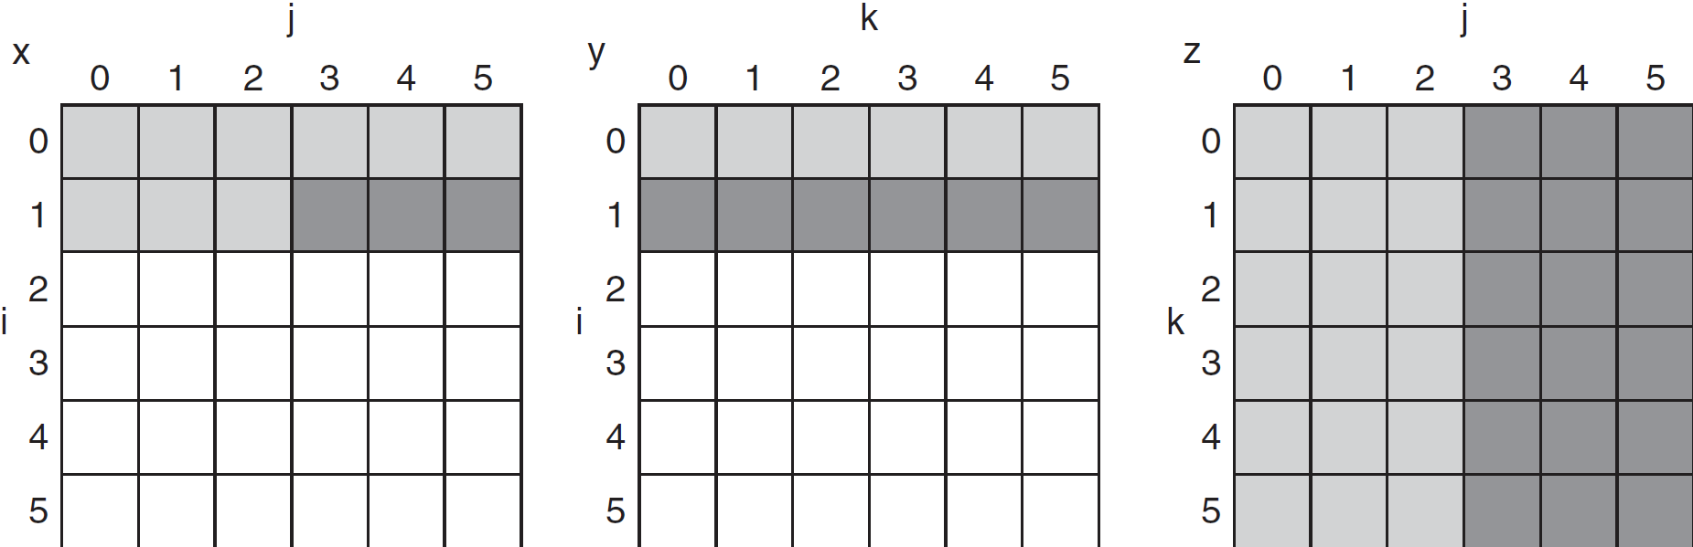
DGEMM Access Pattern
C, A, and B arrays
older accesses
new accesses
Chapter 5 — Large and Fast: Exploiting Memory Hierarchy — ‹#›

Slide 57
Cache Blocked DGEMM
1 #define BLOCKSIZE 32
2 void do_block (int n, int si, int sj, int sk, double *A, double
3 *B, double *C)
4 {
5 for (int i = si; i < si+BLOCKSIZE; ++i)
6 for (int j = sj; j < sj+BLOCKSIZE; ++j)
7 {
8 double cij = C[i+j*n];/* cij = C[i][j] */
9 for( int k = sk; k < sk+BLOCKSIZE; k++ )
10 cij += A[i+k*n] * B[k+j*n];/* cij+=A[i][k]*B[k][j] */
11 C[i+j*n] = cij;/* C[i][j] = cij */
12 }
13 }
14 void dgemm (int n, double* A, double* B, double* C)
15 {
16 for ( int sj = 0; sj < n; sj += BLOCKSIZE )
17 for ( int si = 0; si < n; si += BLOCKSIZE )
18 for ( int sk = 0; sk < n; sk += BLOCKSIZE )
19 do_block(n, si, sj, sk, A, B, C);
20 }
Chapter 5 — Large and Fast: Exploiting Memory Hierarchy — ‹#›

Slide 58
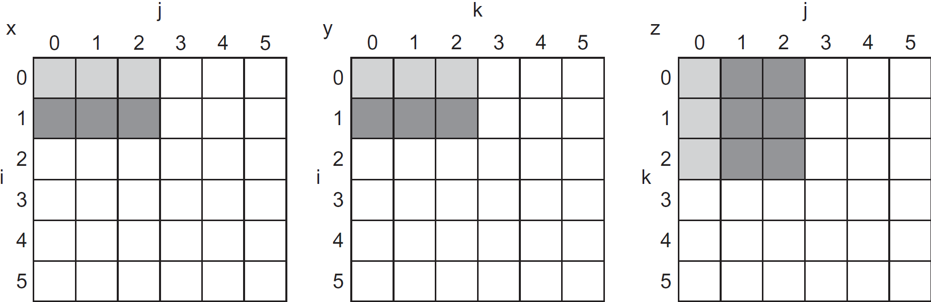
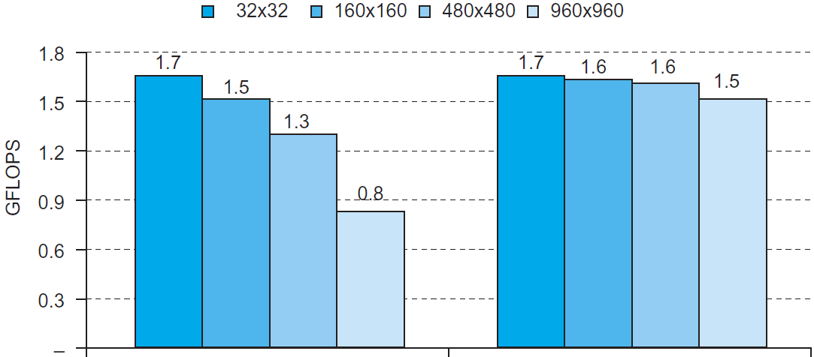
Blocked DGEMM Access Pattern
Unoptimized
Blocked
Chapter 5 — Large and Fast: Exploiting Memory Hierarchy — ‹#›

Slide 59
Dependability
Service accomplishment
Service delivered as specified
§5.5 Dependable Memory Hierarchy
Fault: failure of a component
May or may not lead to system failure
Restoration
Failure
Service interruption
Deviation from specified service
Chapter 6 — Storage and Other I/O Topics — ‹#›
Notes:
Morgan Kaufmann Publishers
*
Chapter 6 — Storage and Other I/O Topics
‹#›

Slide 60
Dependability Measures
Reliability: mean time to failure (MTTF)
Service interruption: mean time to repair (MTTR)
Mean time between failures
MTBF = MTTF + MTTR
Availability = MTTF / (MTTF + MTTR)
Improving Availability
Increase MTTF: fault avoidance, fault tolerance, fault forecasting
Reduce MTTR: improved tools and processes for diagnosis and repair
Chapter 6 — Storage and Other I/O Topics — ‹#›
Notes:
Morgan Kaufmann Publishers
*
Chapter 6 — Storage and Other I/O Topics
‹#›

Slide 61
The Hamming SEC Code
Hamming distance
Number of bits that are different between two bit patterns
Minimum distance = 2 provides single bit error detection
E.g. parity code
Minimum distance = 3 provides single error correction, 2 bit error detection
Chapter 5 — Large and Fast: Exploiting Memory Hierarchy — ‹#›

Slide 62
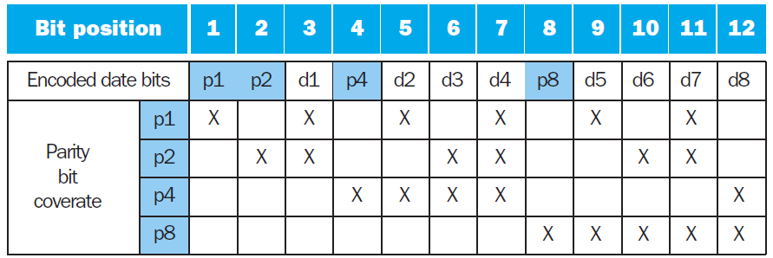
Encoding SEC
To calculate Hamming code:
Number bits from 1 on the left
All bit positions that are a power 2 are parity bits
Each parity bit checks certain data bits:
Chapter 5 — Large and Fast: Exploiting Memory Hierarchy — ‹#›

Slide 63
Decoding SEC
Value of parity bits indicates which bits are in error
Use numbering from encoding procedure
E.g.
Parity bits = 0000 indicates no error
Parity bits = 1010 indicates bit 10 was flipped
Chapter 5 — Large and Fast: Exploiting Memory Hierarchy — ‹#›

Slide 64
SEC/DEC Code
Add an additional parity bit for the whole word (p_{n})
Make Hamming distance = 4
Decoding:
Let H = SEC parity bits
H even, p_{n} even, no error
H odd, p_{n} odd, correctable single bit error
H even, p_{n} odd, error in p_{n} bit
H odd, p_{n} even, double error occurred
Note: ECC DRAM uses SEC/DEC with 8 bits protecting each 64 bits
Chapter 5 — Large and Fast: Exploiting Memory Hierarchy — ‹#›

Slide 65
Virtual Machines
Host computer emulates guest operating system and machine resources
Improved isolation of multiple guests
Avoids security and reliability problems
Aids sharing of resources
Virtualization has some performance impact
Feasible with modern high-performance comptuers
Examples
IBM VM/370 (1970s technology!)
VMWare
Microsoft Virtual PC
§5.6 Virtual Machines
Chapter 5 — Large and Fast: Exploiting Memory Hierarchy — ‹#›
Notes:
Morgan Kaufmann Publishers
*
Chapter 5 — Large and Fast: Exploiting Memory Hierarchy
‹#›

Slide 66
Virtual Machine Monitor
Maps virtual resources to physical resources
Memory, I/O devices, CPUs
Guest code runs on native machine in user mode
Traps to VMM on privileged instructions and access to protected resources
Guest OS may be different from host OS
VMM handles real I/O devices
Emulates generic virtual I/O devices for guest
Chapter 5 — Large and Fast: Exploiting Memory Hierarchy — ‹#›
Notes:
Morgan Kaufmann Publishers
*
Chapter 5 — Large and Fast: Exploiting Memory Hierarchy
‹#›

Slide 67
Example: Timer Virtualization
In native machine, on timer interrupt
OS suspends current process, handles interrupt, selects and resumes next process
With Virtual Machine Monitor
VMM suspends current VM, handles interrupt, selects and resumes next VM
If a VM requires timer interrupts
VMM emulates a virtual timer
Emulates interrupt for VM when physical timer interrupt occurs
Chapter 5 — Large and Fast: Exploiting Memory Hierarchy — ‹#›
Notes:
Morgan Kaufmann Publishers
*
Chapter 5 — Large and Fast: Exploiting Memory Hierarchy
‹#›

Slide 68
Instruction Set Support
User and System modes
Privileged instructions only available in system mode
Trap to system if executed in user mode
All physical resources only accessible using privileged instructions
Including page tables, interrupt controls, I/O registers
Renaissance of virtualization support
Current ISAs (e.g., x86) adapting
Chapter 5 — Large and Fast: Exploiting Memory Hierarchy — ‹#›
Notes:
Morgan Kaufmann Publishers
*
Chapter 5 — Large and Fast: Exploiting Memory Hierarchy
‹#›

Slide 69
Virtual Memory
§5.7 Virtual Memory
Use main memory as a “cache” for secondary (disk) storage
Managed jointly by CPU hardware and the operating system (OS)
Programs share main memory
Each gets a private virtual address space holding its frequently used code and data
Protected from other programs
CPU and OS translate virtual addresses to physical addresses
VM “block” is called a page
VM translation “miss” is called a page fault
Chapter 5 — Large and Fast: Exploiting Memory Hierarchy — ‹#›
Notes:
Morgan Kaufmann Publishers
*
Chapter 5 — Large and Fast: Exploiting Memory Hierarchy
‹#›

Slide 70
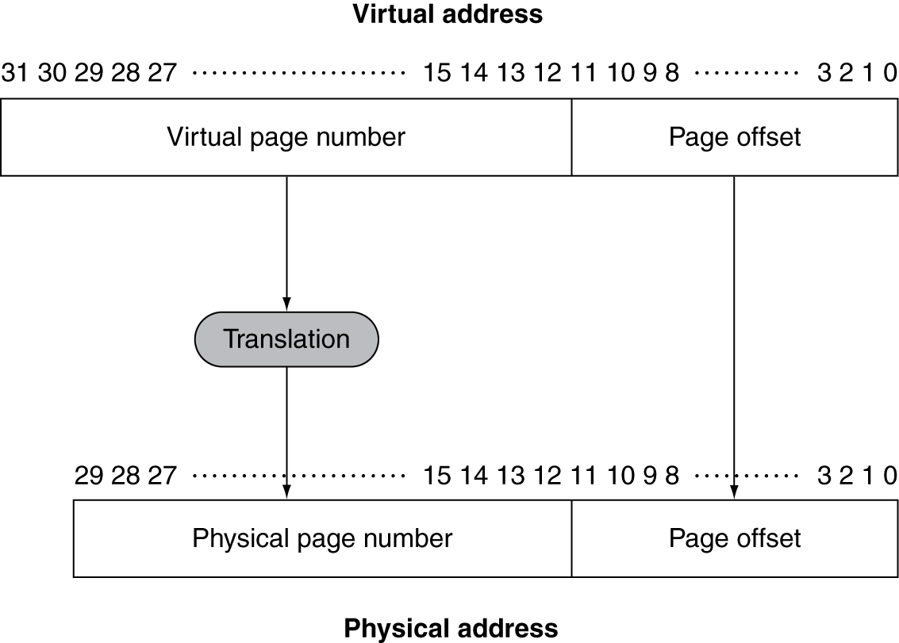
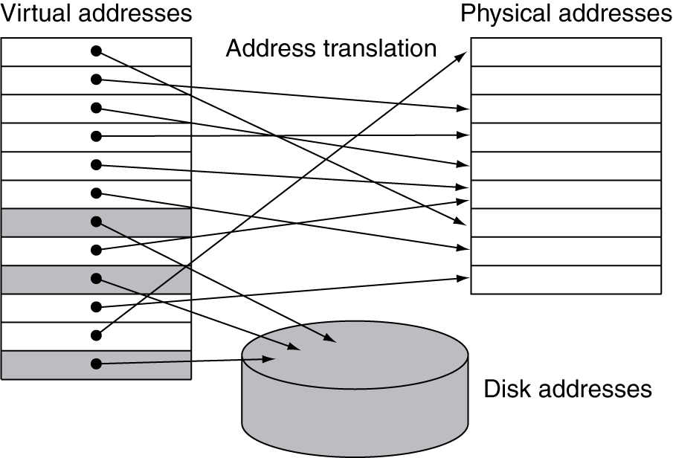
Address Translation
Fixed-size pages (e.g., 4K)
Chapter 5 — Large and Fast: Exploiting Memory Hierarchy — ‹#›
Notes:
Morgan Kaufmann Publishers
*
Chapter 5 — Large and Fast: Exploiting Memory Hierarchy
‹#›

Slide 71
Page Fault Penalty
On page fault, the page must be fetched from disk
Takes millions of clock cycles
Handled by OS code
Try to minimize page fault rate
Fully associative placement
Smart replacement algorithms
Chapter 5 — Large and Fast: Exploiting Memory Hierarchy — ‹#›
Notes:
Morgan Kaufmann Publishers
*
Chapter 5 — Large and Fast: Exploiting Memory Hierarchy
‹#›

Slide 72
Page Tables
Stores placement information
Array of page table entries, indexed by virtual page number
Page table register in CPU points to page table in physical memory
If page is present in memory
PTE stores the physical page number
Plus other status bits (referenced, dirty, …)
If page is not present
PTE can refer to location in swap space on disk
Chapter 5 — Large and Fast: Exploiting Memory Hierarchy — ‹#›
Notes:
Morgan Kaufmann Publishers
*
Chapter 5 — Large and Fast: Exploiting Memory Hierarchy
‹#›

Slide 73
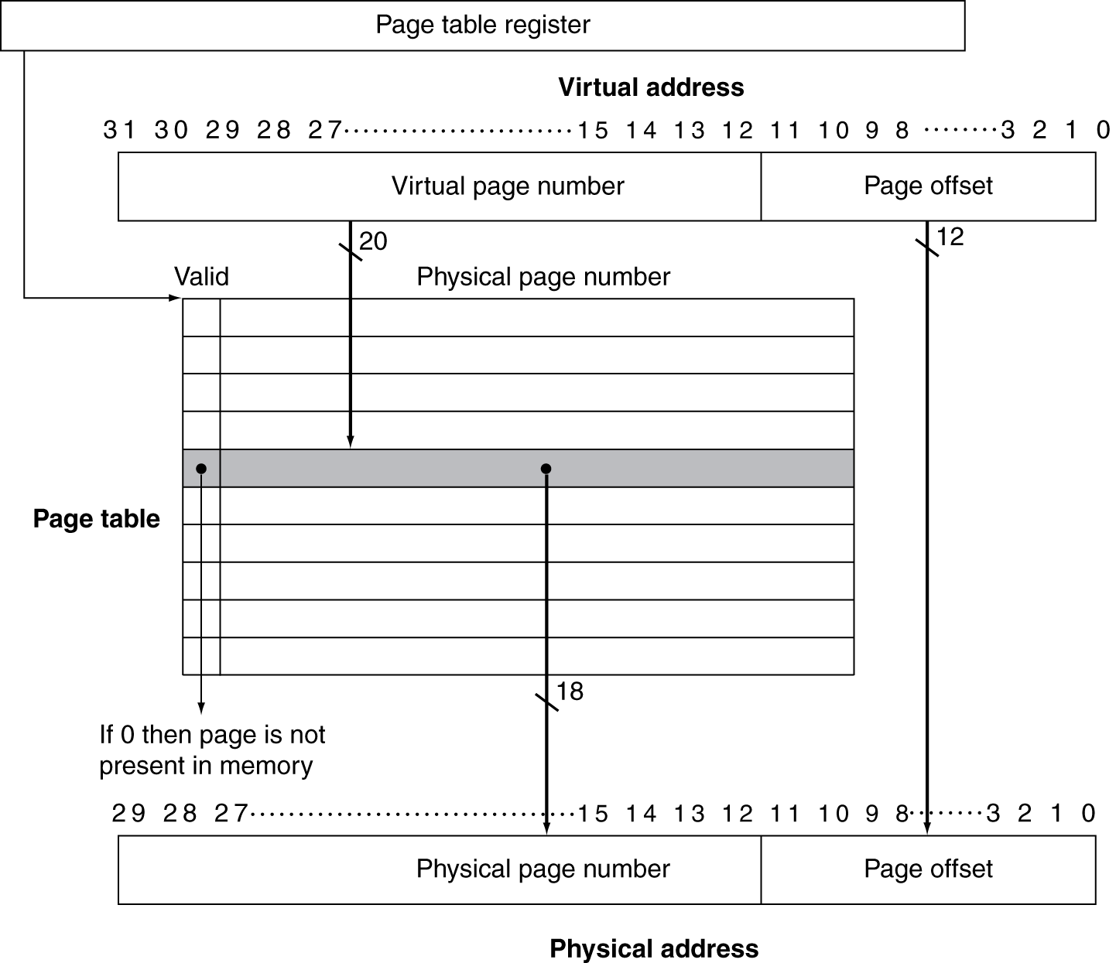
Translation Using a Page Table
Chapter 5 — Large and Fast: Exploiting Memory Hierarchy — ‹#›
Notes:
Morgan Kaufmann Publishers
*
Chapter 5 — Large and Fast: Exploiting Memory Hierarchy
‹#›

Slide 74
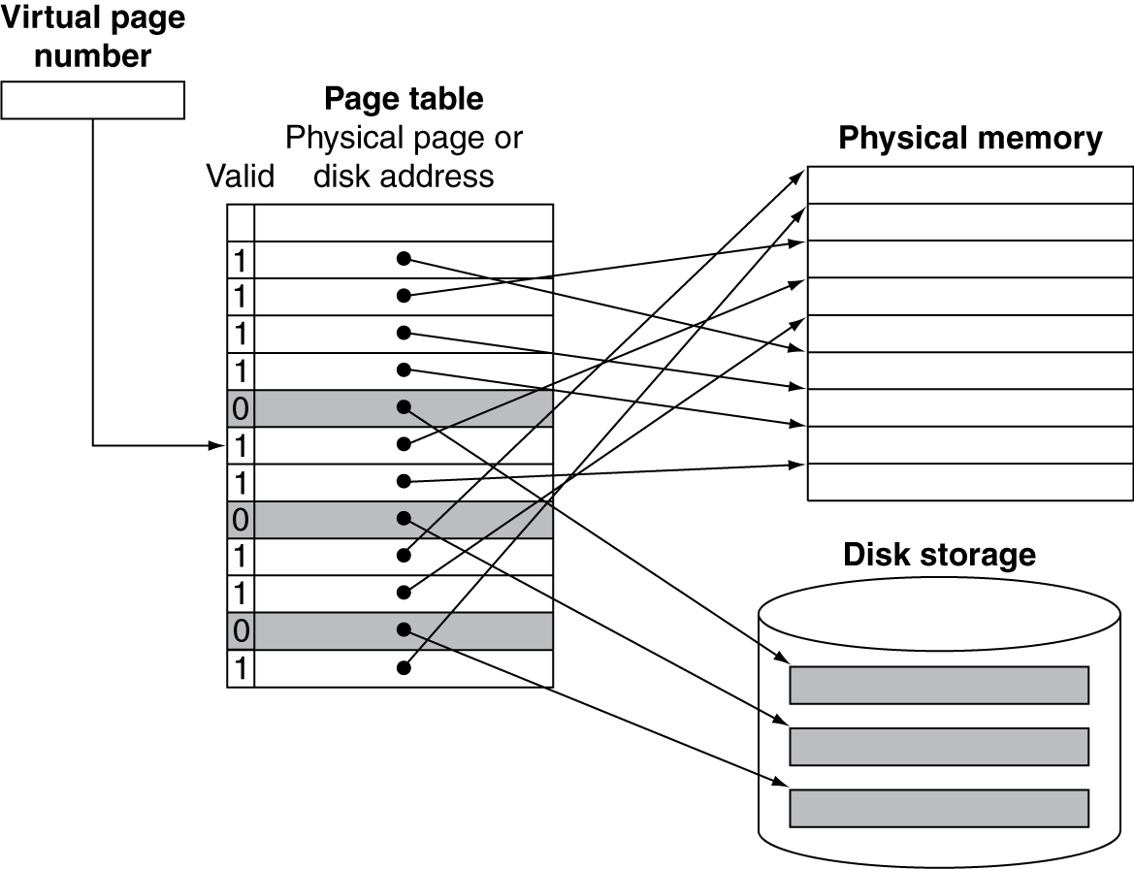
Mapping Pages to Storage
Chapter 5 — Large and Fast: Exploiting Memory Hierarchy — ‹#›
Notes:
Morgan Kaufmann Publishers
*
Chapter 5 — Large and Fast: Exploiting Memory Hierarchy
‹#›

Slide 75
Replacement and Writes
To reduce page fault rate, prefer least-recently used (LRU) replacement
Reference bit (aka use bit) in PTE set to 1 on access to page
Periodically cleared to 0 by OS
A page with reference bit = 0 has not been used recently
Disk writes take millions of cycles
Block at once, not individual locations
Write through is impractical
Use write-back
Dirty bit in PTE set when page is written
Chapter 5 — Large and Fast: Exploiting Memory Hierarchy — ‹#›
Notes:
Morgan Kaufmann Publishers
*
Chapter 5 — Large and Fast: Exploiting Memory Hierarchy
‹#›

Slide 76
Fast Translation Using a TLB
Address translation would appear to require extra memory references
One to access the PTE
Then the actual memory access
But access to page tables has good locality
So use a fast cache of PTEs within the CPU
Called a Translation Look-aside Buffer (TLB)
Typical: 16–512 PTEs, 0.5–1 cycle for hit, 10–100 cycles for miss, 0.01%–1% miss rate
Misses could be handled by hardware or software
Chapter 5 — Large and Fast: Exploiting Memory Hierarchy — ‹#›
Notes:
Morgan Kaufmann Publishers
*
Chapter 5 — Large and Fast: Exploiting Memory Hierarchy
‹#›

Slide 77
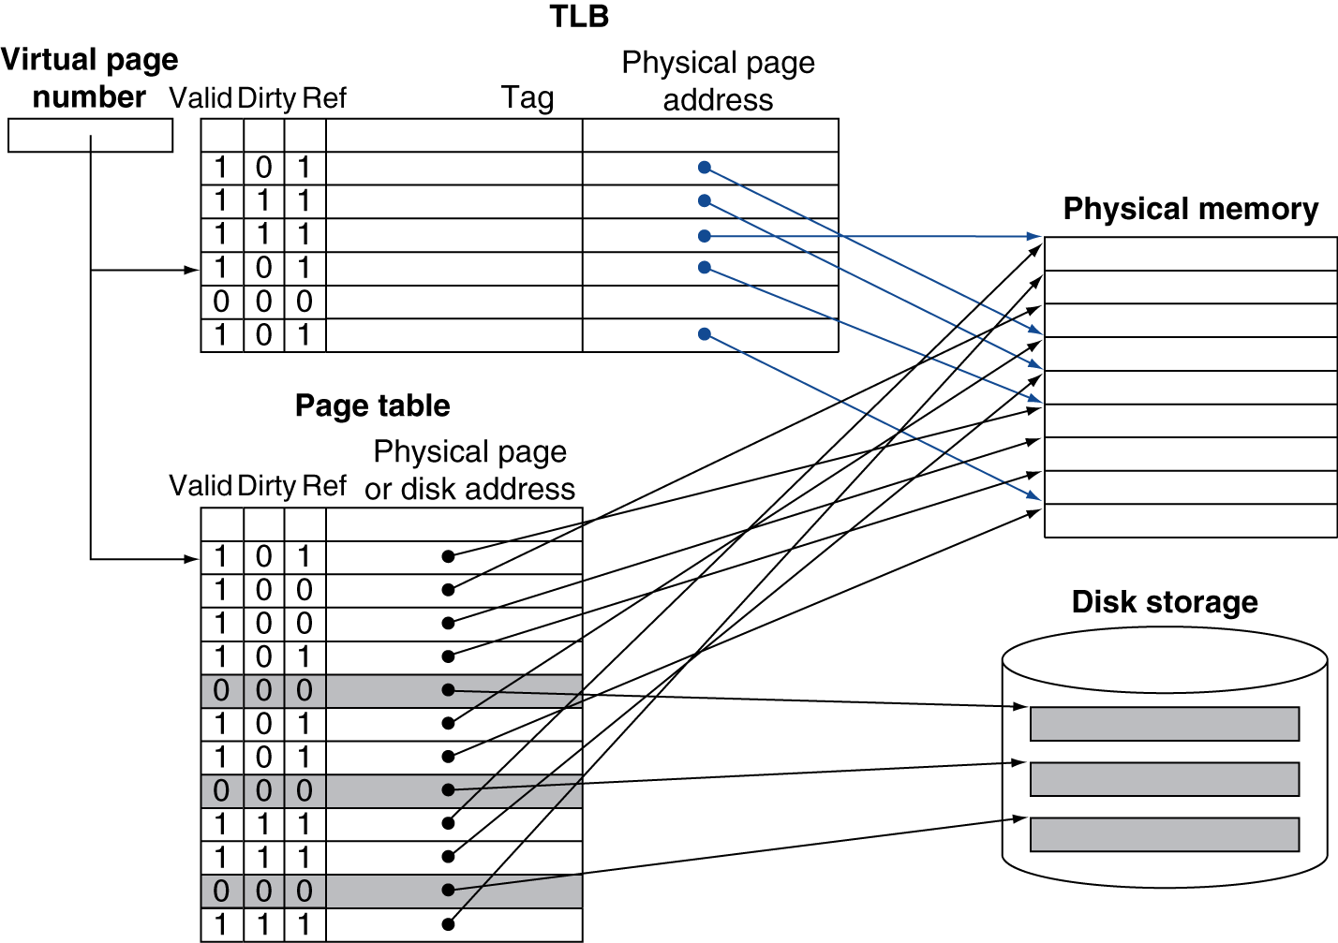
Fast Translation Using a TLB
Chapter 5 — Large and Fast: Exploiting Memory Hierarchy — ‹#›
Notes:
Morgan Kaufmann Publishers
*
Chapter 5 — Large and Fast: Exploiting Memory Hierarchy
‹#›

Slide 78
TLB Misses
If page is in memory
Load the PTE from memory and retry
Could be handled in hardware
Can get complex for more complicated page table structures
Or in software
Raise a special exception, with optimized handler
If page is not in memory (page fault)
OS handles fetching the page and updating the page table
Then restart the faulting instruction
Chapter 5 — Large and Fast: Exploiting Memory Hierarchy — ‹#›
Notes:
Morgan Kaufmann Publishers
*
Chapter 5 — Large and Fast: Exploiting Memory Hierarchy
‹#›

Slide 79
TLB Miss Handler
TLB miss indicates
Page present, but PTE not in TLB
Page not preset
Must recognize TLB miss before destination register overwritten
Raise exception
Handler copies PTE from memory to TLB
Then restarts instruction
If page not present, page fault will occur
Chapter 5 — Large and Fast: Exploiting Memory Hierarchy — ‹#›
Notes:
Morgan Kaufmann Publishers
*
Chapter 5 — Large and Fast: Exploiting Memory Hierarchy
‹#›

Slide 80
Page Fault Handler
Use faulting virtual address to find PTE
Locate page on disk
Choose page to replace
If dirty, write to disk first
Read page into memory and update page table
Make process runnable again
Restart from faulting instruction
Chapter 5 — Large and Fast: Exploiting Memory Hierarchy — ‹#›
Notes:
Morgan Kaufmann Publishers
*
Chapter 5 — Large and Fast: Exploiting Memory Hierarchy
‹#›

Slide 81
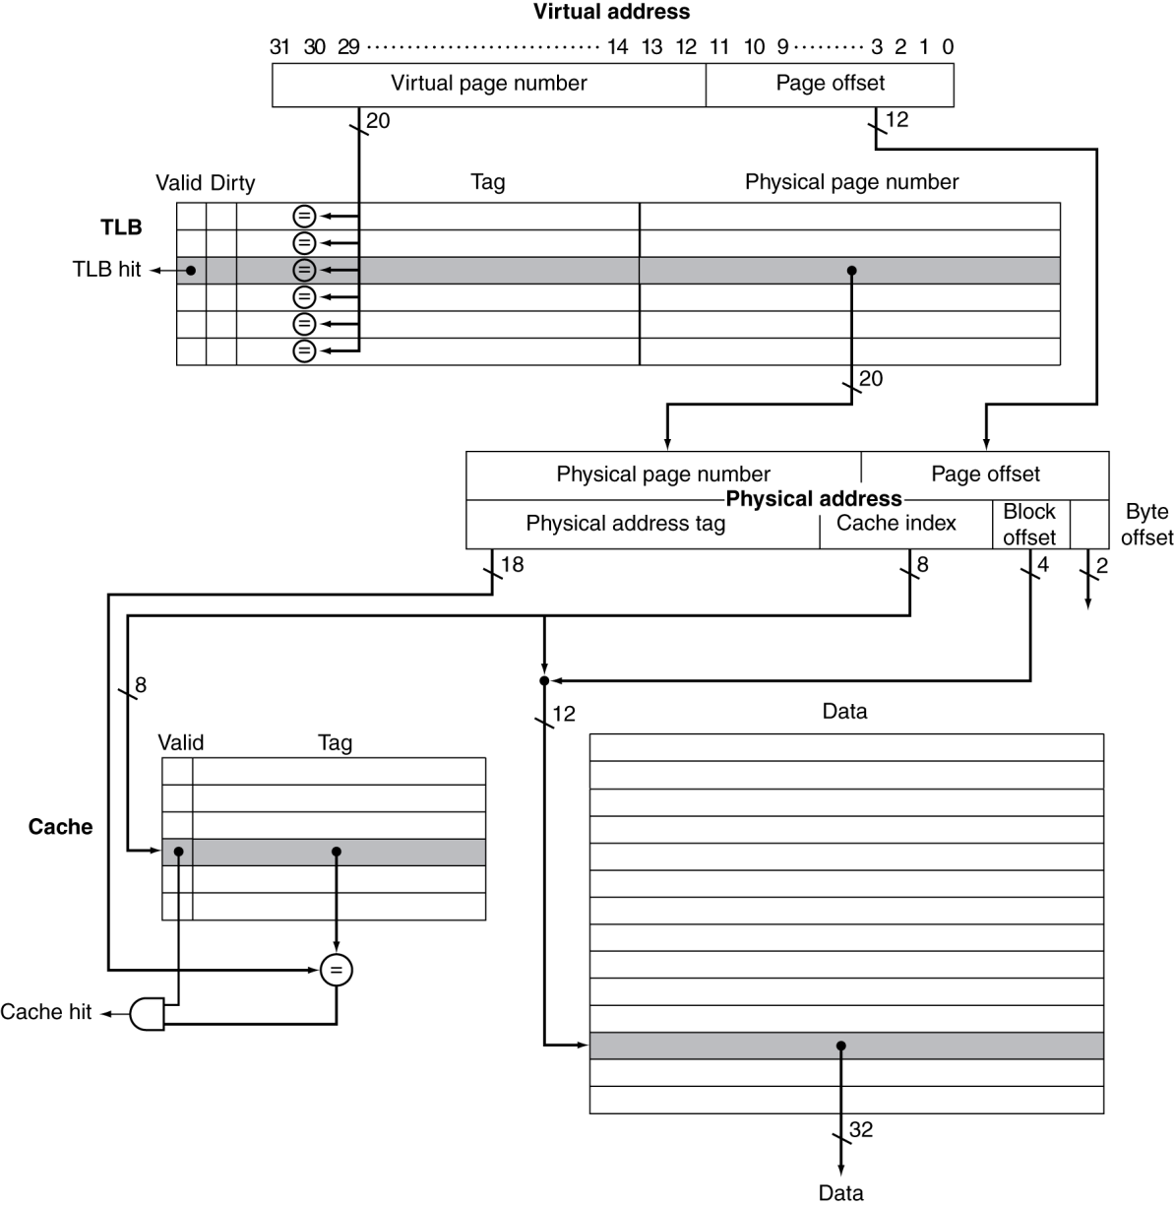
TLB and Cache Interaction
If cache tag uses physical address
Need to translate before cache lookup
Alternative: use virtual address tag
Complications due to aliasing
Different virtual addresses for shared physical address
Chapter 5 — Large and Fast: Exploiting Memory Hierarchy — ‹#›
Notes:
Morgan Kaufmann Publishers
*
Chapter 5 — Large and Fast: Exploiting Memory Hierarchy
‹#›

Slide 82
Memory Protection
Different tasks can share parts of their virtual address spaces
But need to protect against errant access
Requires OS assistance
Hardware support for OS protection
Privileged supervisor mode (aka kernel mode)
Privileged instructions
Page tables and other state information only accessible in supervisor mode
System call exception (e.g., syscall in MIPS)
Chapter 5 — Large and Fast: Exploiting Memory Hierarchy — ‹#›
Notes:
Morgan Kaufmann Publishers
*
Chapter 5 — Large and Fast: Exploiting Memory Hierarchy
‹#›

Slide 83
The Memory Hierarchy
The BIG Picture
Common principles apply at all levels of the memory hierarchy
Based on notions of caching
At each level in the hierarchy
Block placement
Finding a block
Replacement on a miss
Write policy
§5.8 A Common Framework for Memory Hierarchies
Chapter 5 — Large and Fast: Exploiting Memory Hierarchy — ‹#›
Notes:
Morgan Kaufmann Publishers
*
Chapter 5 — Large and Fast: Exploiting Memory Hierarchy
‹#›

Slide 84
Block Placement
Determined by associativity
Direct mapped (1-way associative)
One choice for placement
n-way set associative
n choices within a set
Fully associative
Any location
Higher associativity reduces miss rate
Increases complexity, cost, and access time
Chapter 5 — Large and Fast: Exploiting Memory Hierarchy — ‹#›
Notes:
Morgan Kaufmann Publishers
*
Chapter 5 — Large and Fast: Exploiting Memory Hierarchy
‹#›

Slide 85
Finding a Block
Associativity | Location method | Tag comparisons
Direct mapped | Index | 1
n-way set associative | Set index, then search entries within the set | n
Fully associative | Search all entries | #entries
 | Full lookup table | 0
Hardware caches
Reduce comparisons to reduce cost
Virtual memory
Full table lookup makes full associativity feasible
Benefit in reduced miss rate
Chapter 5 — Large and Fast: Exploiting Memory Hierarchy — ‹#›
Notes:
Morgan Kaufmann Publishers
*
Chapter 5 — Large and Fast: Exploiting Memory Hierarchy
‹#›

Slide 86
Replacement
Choice of entry to replace on a miss
Least recently used (LRU)
Complex and costly hardware for high associativity
Random
Close to LRU, easier to implement
Virtual memory
LRU approximation with hardware support
Chapter 5 — Large and Fast: Exploiting Memory Hierarchy — ‹#›
Notes:
Morgan Kaufmann Publishers
*
Chapter 5 — Large and Fast: Exploiting Memory Hierarchy
‹#›

Slide 87
Write Policy
Write-through
Update both upper and lower levels
Simplifies replacement, but may require write buffer
Write-back
Update upper level only
Update lower level when block is replaced
Need to keep more state
Virtual memory
Only write-back is feasible, given disk write latency
Chapter 5 — Large and Fast: Exploiting Memory Hierarchy — ‹#›
Notes:
Morgan Kaufmann Publishers
*
Chapter 5 — Large and Fast: Exploiting Memory Hierarchy
‹#›

Slide 88
Sources of Misses
Compulsory misses (aka cold start misses)
First access to a block
Capacity misses
Due to finite cache size
A replaced block is later accessed again
Conflict misses (aka collision misses)
In a non-fully associative cache
Due to competition for entries in a set
Would not occur in a fully associative cache of the same total size
Chapter 5 — Large and Fast: Exploiting Memory Hierarchy — ‹#›
Notes:
Morgan Kaufmann Publishers
*
Chapter 5 — Large and Fast: Exploiting Memory Hierarchy
‹#›

Slide 89
Cache Design Trade-offs
Design change | Effect on miss rate | Negative performance effect
Increase cache size | Decrease capacity misses | May increase access time
Increase associativity | Decrease conflict misses | May increase access time
Increase block size | Decrease compulsory misses | Increases miss penalty. For very large block size, may increase miss rate due to pollution.
Chapter 5 — Large and Fast: Exploiting Memory Hierarchy — ‹#›
Notes:
Morgan Kaufmann Publishers
*
Chapter 5 — Large and Fast: Exploiting Memory Hierarchy
‹#›

Slide 90
Cache Control
Example cache characteristics
Direct-mapped, write-back, write allocate
Block size: 4 words (16 bytes)
Cache size: 16 KB (1024 blocks)
32-bit byte addresses
Valid bit and dirty bit per block
Blocking cache
CPU waits until access is complete
§5.9 Using a Finite State Machine to Control A Simple Cache
31
10
9
4
3
0
Tag
Index
Offset
18 bits
10 bits
4 bits
Chapter 5 — Large and Fast: Exploiting Memory Hierarchy — ‹#›
Notes:
Morgan Kaufmann Publishers
*
Chapter 5 — Large and Fast: Exploiting Memory Hierarchy
‹#›

Slide 91
Interface Signals
CPU
Cache
Memory
Read/Write
Read/Write
Valid
Valid
Address
32
Address
32
Write Data
32
Write Data
128
Read Data
32
Read Data
128
Ready
Ready
Multiple cycles per access
Chapter 5 — Large and Fast: Exploiting Memory Hierarchy — ‹#›
Notes:
Morgan Kaufmann Publishers
*
Chapter 5 — Large and Fast: Exploiting Memory Hierarchy
‹#›

Slide 92
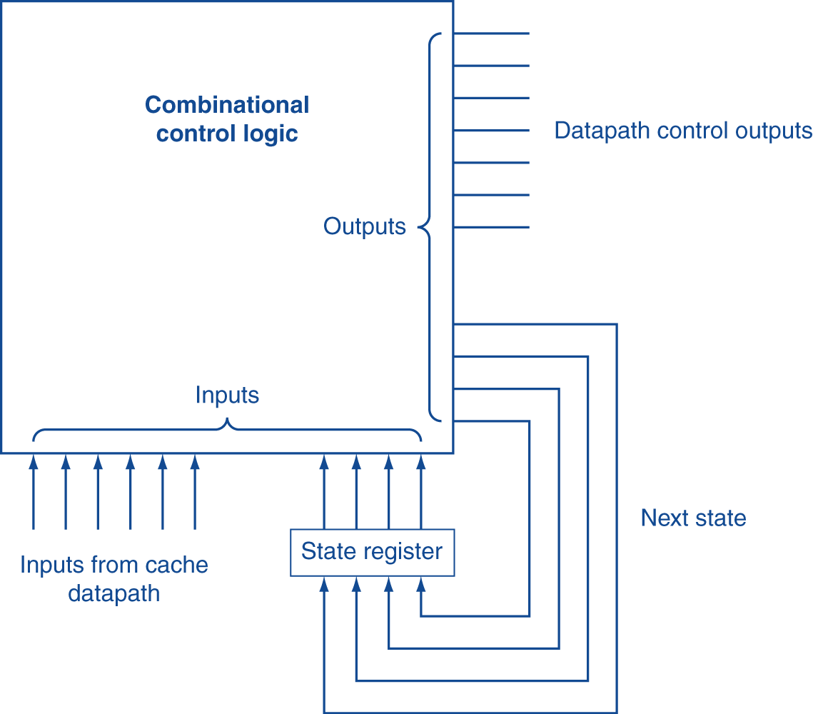
Finite State Machines
Use an FSM to sequence control steps
Set of states, transition on each clock edge
State values are binary encoded
Current state stored in a register
Next state = f_{n} (current state, current inputs)
Control output signals = f_{o} (current state)
Chapter 5 — Large and Fast: Exploiting Memory Hierarchy — ‹#›
Notes:
Morgan Kaufmann Publishers
*
Chapter 5 — Large and Fast: Exploiting Memory Hierarchy
‹#›

Slide 93
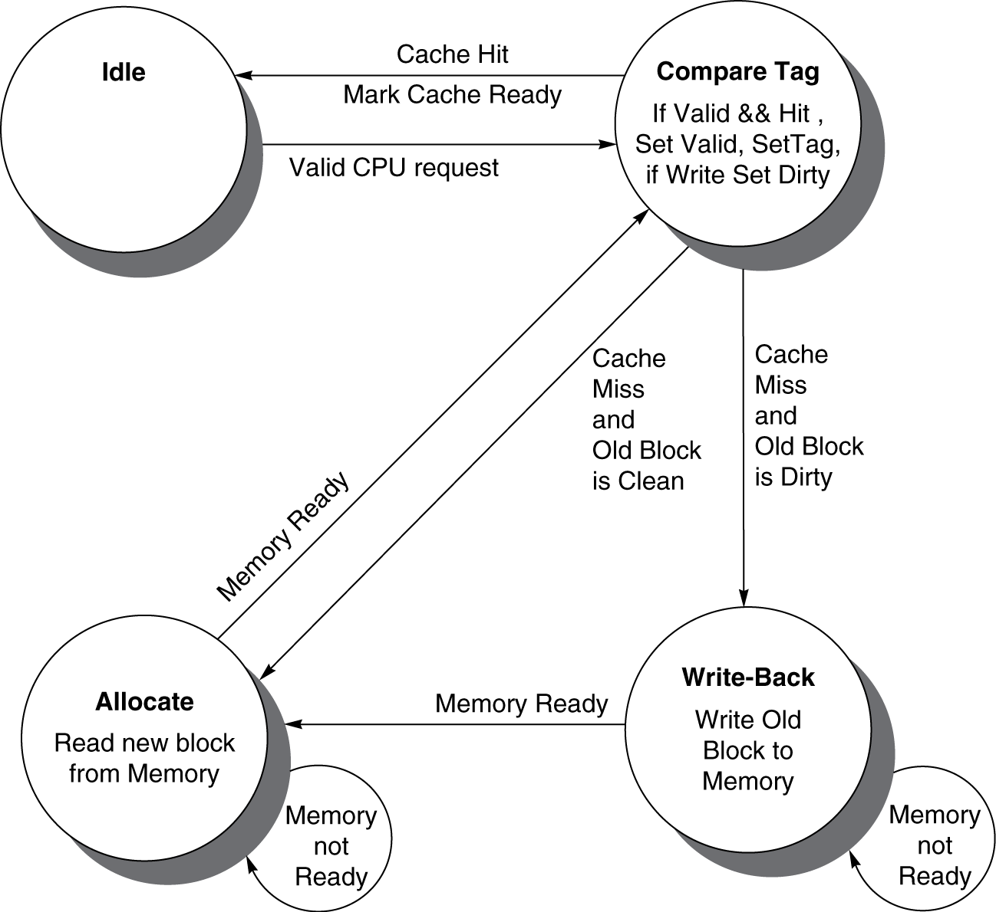
Cache Controller FSM
Could partition into separate states to reduce clock cycle time
Chapter 5 — Large and Fast: Exploiting Memory Hierarchy — ‹#›
Notes:
Morgan Kaufmann Publishers
*
Chapter 5 — Large and Fast: Exploiting Memory Hierarchy
‹#›

Slide 94
Cache Coherence Problem
Suppose two CPU cores share a physical address space
Write-through caches
Time step | Event | CPU A’s cache | CPU B’s cache | Memory
0 |  |  |  | 0
1 | CPU A reads X | 0 |  | 0
2 | CPU B reads X | 0 | 0 | 0
3 | CPU A writes 1 to X | 1 | 0 | 1
§5.10 Parallelism and Memory Hierarchies: Cache Coherence
Chapter 5 — Large and Fast: Exploiting Memory Hierarchy — ‹#›
Notes:
Morgan Kaufmann Publishers
*
Chapter 5 — Large and Fast: Exploiting Memory Hierarchy
‹#›

Slide 95
Coherence Defined
Informally: Reads return most recently written value
Formally:
P writes X; P reads X (no intervening writes) ⇒ read returns written value
P₁ writes X; P₂ reads X (sufficiently later) ⇒ read returns written value
c.f. CPU B reading X after step 3 in example
P₁ writes X, P₂ writes X ⇒ all processors see writes in the same order
End up with the same final value for X
Chapter 5 — Large and Fast: Exploiting Memory Hierarchy — ‹#›
Notes:
Morgan Kaufmann Publishers
*
Chapter 5 — Large and Fast: Exploiting Memory Hierarchy
‹#›

Slide 96
Cache Coherence Protocols
Operations performed by caches in multiprocessors to ensure coherence
Migration of data to local caches
Reduces bandwidth for shared memory
Replication of read-shared data
Reduces contention for access
Snooping protocols
Each cache monitors bus reads/writes
Directory-based protocols
Caches and memory record sharing status of blocks in a directory
Chapter 5 — Large and Fast: Exploiting Memory Hierarchy — ‹#›
Notes:
Morgan Kaufmann Publishers
*
Chapter 5 — Large and Fast: Exploiting Memory Hierarchy
‹#›

Slide 97
Invalidating Snooping Protocols
Cache gets exclusive access to a block when it is to be written
Broadcasts an invalidate message on the bus
Subsequent read in another cache misses
Owning cache supplies updated value
CPU activity | Bus activity | CPU A’s cache | CPU B’s cache | Memory
 |  |  |  | 0
CPU A reads X | Cache miss for X | 0 |  | 0
CPU B reads X | Cache miss for X | 0 | 0 | 0
CPU A writes 1 to X | Invalidate for X | 1 |  | 0
CPU B read X | Cache miss for X | 1 | 1 | 1
Chapter 5 — Large and Fast: Exploiting Memory Hierarchy — ‹#›
Notes:
Morgan Kaufmann Publishers
*
Chapter 5 — Large and Fast: Exploiting Memory Hierarchy
‹#›

Slide 98
Memory Consistency
When are writes seen by other processors
“Seen” means a read returns the written value
Can’t be instantaneously
Assumptions
A write completes only when all processors have seen it
A processor does not reorder writes with other accesses
Consequence
P writes X then writes Y ⇒ all processors that see new Y also see new X
Processors can reorder reads, but not writes
Chapter 5 — Large and Fast: Exploiting Memory Hierarchy — ‹#›
Notes:
Morgan Kaufmann Publishers
*
Chapter 5 — Large and Fast: Exploiting Memory Hierarchy
‹#›

Slide 99
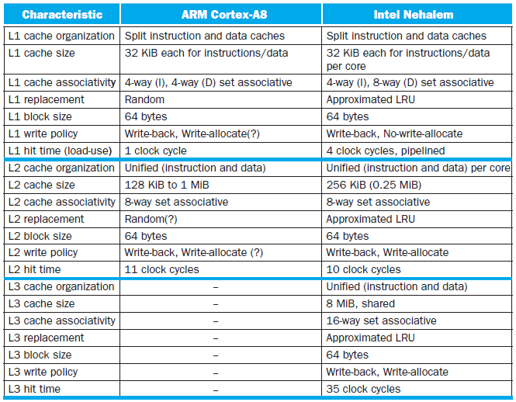
Multilevel On-Chip Caches
§5.13 The ARM Cortex-A8 and Intel Core i7 Memory Hierarchies
Chapter 5 — Large and Fast: Exploiting Memory Hierarchy — ‹#›
Notes:
Morgan Kaufmann Publishers
*
Chapter 5 — Large and Fast: Exploiting Memory Hierarchy
‹#›

Slide 100
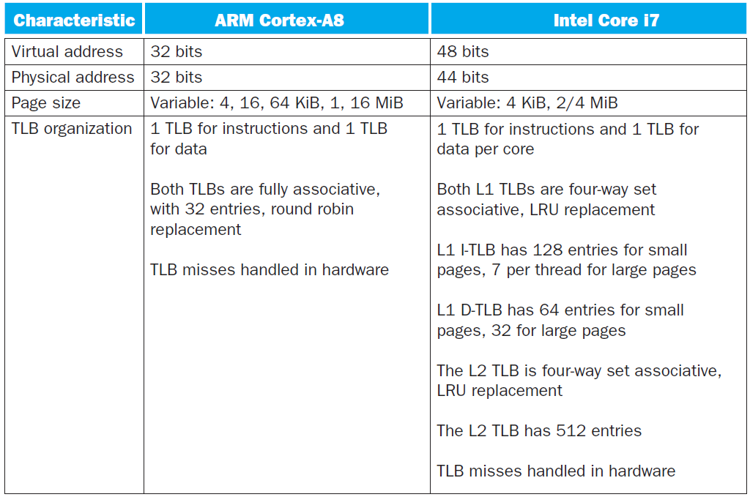
2-Level TLB Organization
Chapter 5 — Large and Fast: Exploiting Memory Hierarchy — ‹#›
Notes:
Morgan Kaufmann Publishers
*
Chapter 5 — Large and Fast: Exploiting Memory Hierarchy
‹#›

Slide 101
Supporting Multiple Issue
Both have multi-banked caches that allow multiple accesses per cycle assuming no bank conflicts
Core i7 cache optimizations
Return requested word first
Non-blocking cache
Hit under miss
Miss under miss
Data prefetching
Chapter 5 — Large and Fast: Exploiting Memory Hierarchy — ‹#›
Notes:
Morgan Kaufmann Publishers
*
Chapter 5 — Large and Fast: Exploiting Memory Hierarchy
‹#›

Slide 102
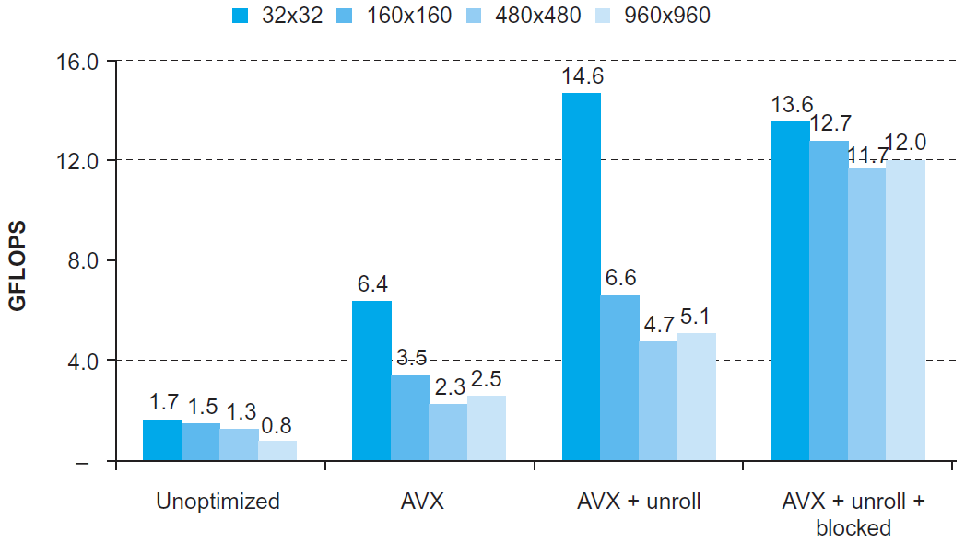
DGEMM
Combine cache blocking and subword parallelism
§5.14 Going Faster: Cache Blocking and Matrix Multiply
Chapter 5 — Large and Fast: Exploiting Memory Hierarchy — ‹#›

Slide 103
Pitfalls
Byte vs. word addressing
Example: 32-byte direct-mapped cache, 4-byte blocks
Byte 36 maps to block 1
Word 36 maps to block 4
Ignoring memory system effects when writing or generating code
Example: iterating over rows vs. columns of arrays
Large strides result in poor locality
§5.15 Fallacies and Pitfalls
Chapter 5 — Large and Fast: Exploiting Memory Hierarchy — ‹#›
Notes:
Morgan Kaufmann Publishers
*
Chapter 5 — Large and Fast: Exploiting Memory Hierarchy
‹#›

Slide 104
Pitfalls
In multiprocessor with shared L2 or L3 cache
Less associativity than cores results in conflict misses
More cores ⇒ need to increase associativity
Using AMAT to evaluate performance of out-of-order processors
Ignores effect of non-blocked accesses
Instead, evaluate performance by simulation
Chapter 5 — Large and Fast: Exploiting Memory Hierarchy — ‹#›
Notes:
Morgan Kaufmann Publishers
*
Chapter 5 — Large and Fast: Exploiting Memory Hierarchy
‹#›

Slide 105
Pitfalls
Extending address range using segments
E.g., Intel 80286
But a segment is not always big enough
Makes address arithmetic complicated
Implementing a VMM on an ISA not designed for virtualization
E.g., non-privileged instructions accessing hardware resources
Either extend ISA, or require guest OS not to use problematic instructions
Chapter 5 — Large and Fast: Exploiting Memory Hierarchy — ‹#›
Notes:
Morgan Kaufmann Publishers
*
Chapter 5 — Large and Fast: Exploiting Memory Hierarchy
‹#›

Slide 106
Concluding Remarks
Fast memories are small, large memories are slow
We really want fast, large memories ☹
Caching gives this illusion ☺
Principle of locality
Programs use a small part of their memory space frequently
Memory hierarchy
L1 cache ↔ L2 cache ↔ … ↔ DRAM memory ↔ disk
Memory system design is critical for multiprocessors
§5.16 Concluding Remarks
Chapter 5 — Large and Fast: Exploiting Memory Hierarchy — ‹#›
Notes:
Morgan Kaufmann Publishers
*
Chapter 5 — Large and Fast: Exploiting Memory Hierarchy
‹#›

